Slide 1

Clustering Algorithms
- A Comparative Study of Popular Clustering Techniques

Slide 2
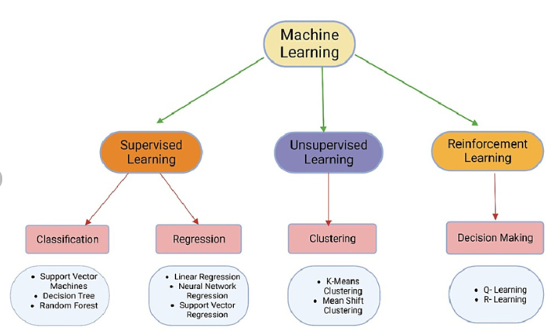
Introduction to Clustering
What is Clustering?
Clustering is an unsupervised learning technique used to group similar data points into clusters.
Applications: Customer segmentation, Image segmentation, Anomaly detection, etc.
Types of Clustering:
Hard Clustering: Each data point belongs to exactly one cluster.
Soft Clustering: Each data point can belong to more than one cluster.

Slide 3
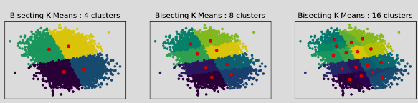
Bisecting K-Means Clustering
Definition: Bisecting K-Means is a hierarchical version of the K-Means algorithm
Process:
Start with all data points in one cluster.
Repeatedly split the cluster with the largest variance until the desired number of clusters is obtained.
Advantages: More stable than standard K-Means
Disadvantage: inability to handle categorical data. The algorithm works with numerical data, where distances between data points can be calculated. However, categorical data doesn’t have a natural notion of distance or similarity.
Use Cases: Text mining, Image processing.
Notes:
K-Means Clustering is an Unsupervised Learning algorithm, which groups the unlabeled dataset into different clusters. Here K defines the number of pre-defined clusters that need to be created in the process. Number of Cluster is found out via elbow method. The location of a bend (knee) in the plot is generally considered as an indicator of the appropriate number of clusters.
Initialize the centroids.
Select the group and find the average.

Slide 4
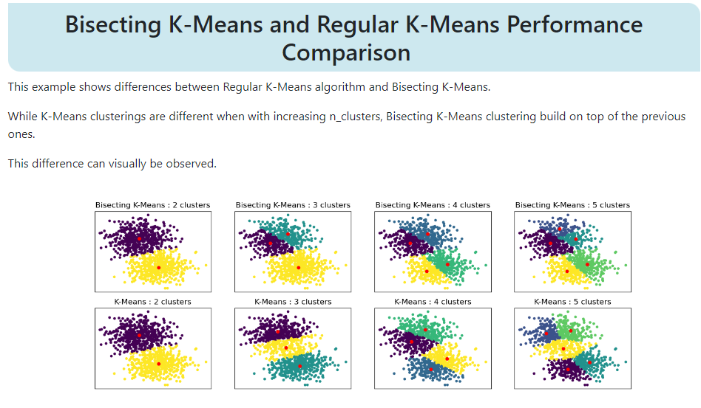
Comparison of K-Means and Bisecting K-means

Slide 5
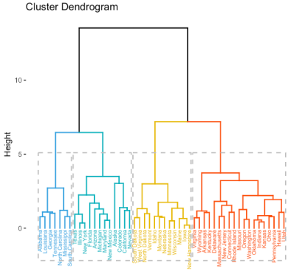
Agglomerative Clustering
Definition: A hierarchical clustering method that builds nested clusters by merging or splitting them successively.
Process:
Start with each data point as a single cluster.
Merge the closest pair of clusters iteratively.
Advantages: No need to specify the number of clusters in advance
Disadvantages: it can be computationally expensive, it does not produce the same number of clusters for different datasets, it can struggle with high-dimensional data
Use Cases: Social network analysis, Gene expression data.

Slide 6
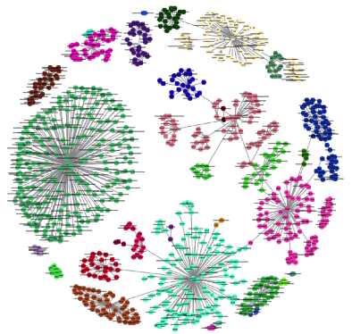
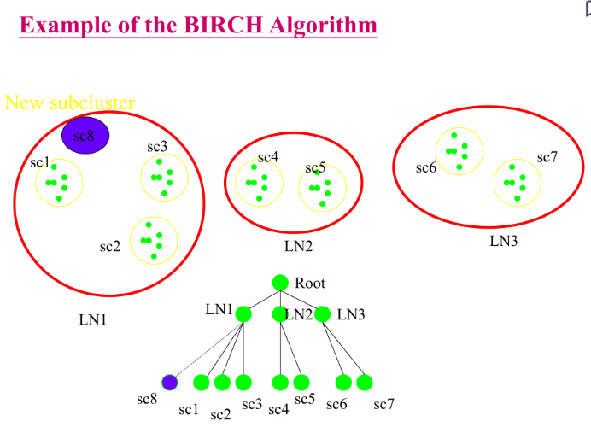
BIRCH Clustering
Definition: BIRCH (Balanced Iterative Reducing and Clustering using Hierarchies) is a hierarchical clustering algorithm designed for large datasets.
Process:
Builds a tree structure called the Clustering Feature (CF) tree.
Incrementally clusters incoming data points.
Advantages: Handles large datasets efficiently. Helps with scaling efficiently
Disadvantages: A main disadvantage of BIRCH (and of most hie clustering methods) is less robustness towards outliers, which will either show additional clusters or even cause other clusters to merge
Use Cases: Image compression, Document clustering.
Notes:
Birch clustering will generate a small and compact summary of a large dataset. This smaller summary is then clustered instead of clustering the large dataset.

Slide 7
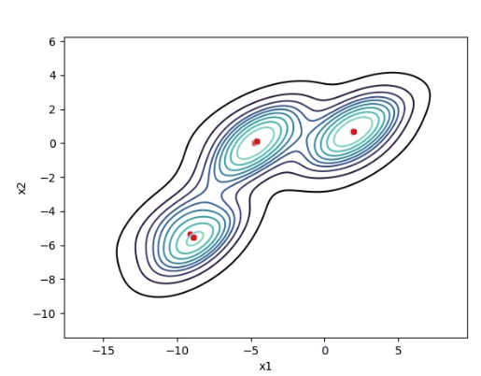
Mean Shift Clustering
Definition: Mean Shift is a non-parametric clustering technique that does not require specifying the number of clusters (as with K means)
Process:
Initialize centroids and shift them towards the densest area (highest data point density).
Iterate until convergence.
Advantages: Flexibility in determining the number of clusters.
Disadvantage:
The performance of Mean Shift clustering is sensitive to the choice of the bandwidth parameter. ...
Mean Shift can be computationally expensive, especially for large datasets.
Use Cases: Image segmentation, Object tracking.
Notes:
It is not required to specify cluster points as with K means.

Slide 8
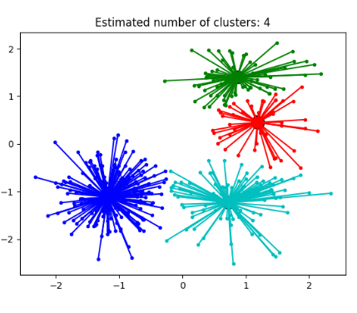
Affinity Propagation Clustering
Definition: Affinity Propagation creates clusters by sending messages between data points until a set of exemplars emerges.
Process:
Messages are exchanged between points about their preference to become exemplars.
Clusters form around these exemplars.
Advantages: Does not require specifying the number of clusters.
Disadvantages: Can be computationally expensive, especially for large datasets, making it unsuitable for large-scale clustering problems.
Use Cases: Face recognition, Text clustering.
Notes:
Affinity propagation will consider every data point as a cluster and via convergence, clusters are formed.

Slide 9
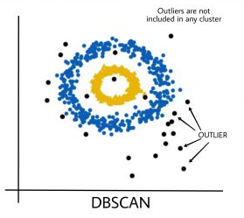
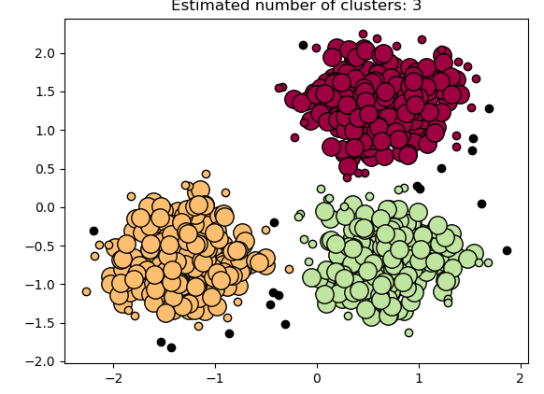
DBSCAN (Density-Based Spatial Clustering of Applications with Noise)
Definition: DBSCAN is a density-based clustering algorithm that forms clusters based on the density of data points.
Process:
It groups ‘densely grouped’ data points into a single cluster
Advantages: Can find arbitrarily shaped clusters, handles noise well
Disadvantages: DBSCAN may perform poorly on data sets with clusters of significantly different densities.
Use Cases: Geospatial data, Anomaly detection.

Slide 10
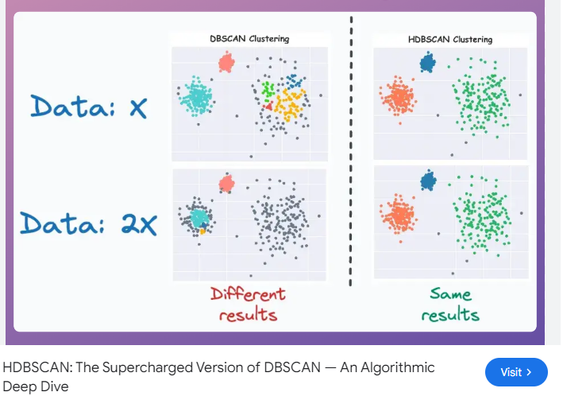
HDBSCAN (Hierarchical DBSCAN)
Definition: HDBSCAN is an extension of DBSCAN that performs clustering in a hierarchical manner.
Process:
Builds a minimum spanning tree of the distance between points.
Condenses it into a hierarchy of clusters.
Advantages: Automatically determines the optimal number of clusters.
Disadvantage: HDBSCAN can be computationally expensive, particularly for large datasets, due to the construction of the minimum spanning tree and the calculation of mutual reachability distances.
Use Cases: Customer segmentation, Fraud detection.
Notes:
a powerful hierarchical clustering algorithm that extends the capabilities of DBSCAN by adding hierarchical clustering and handling varying densities more effectively.

Slide 11
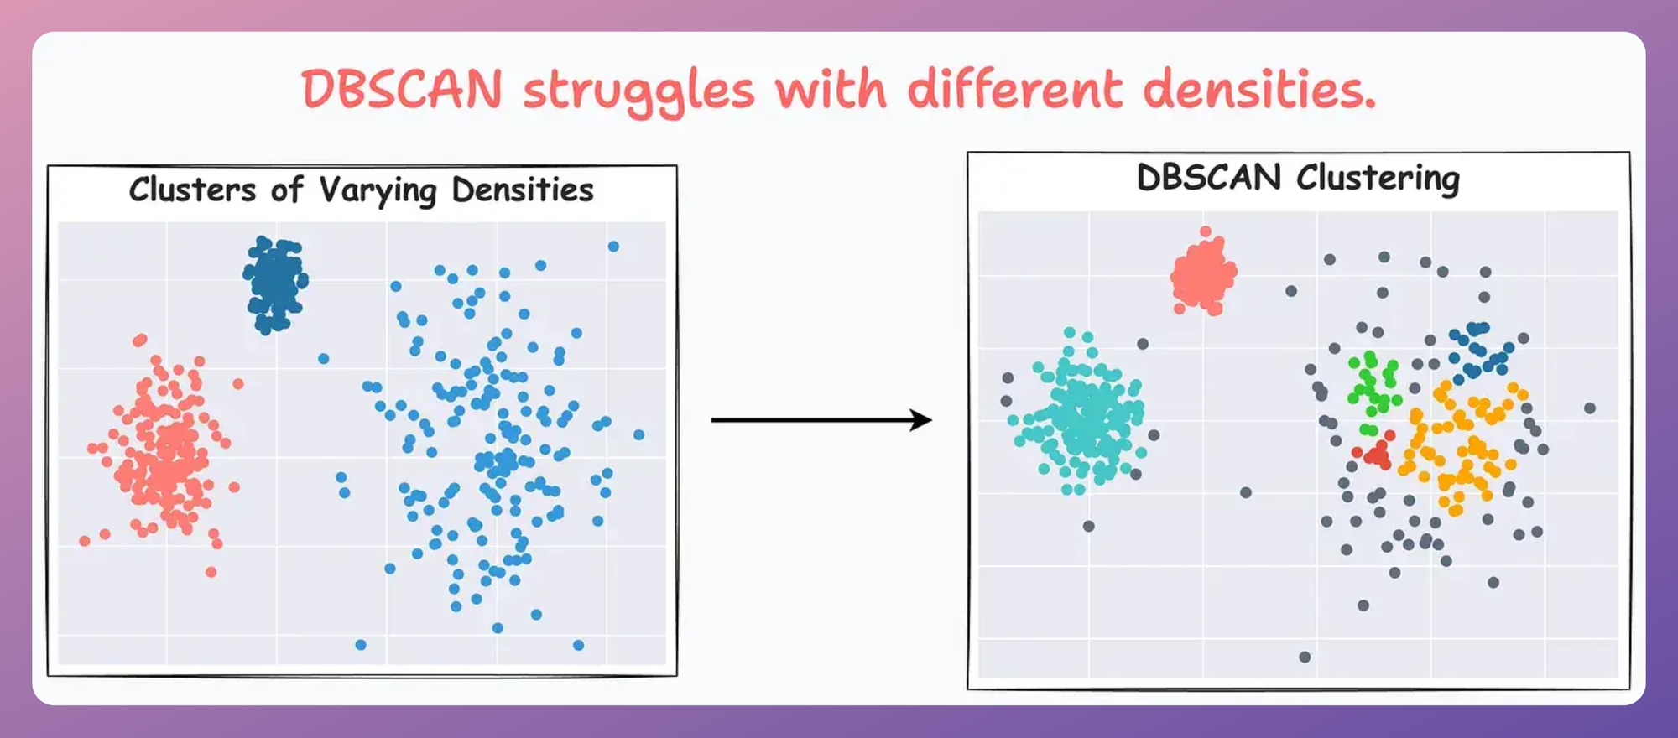
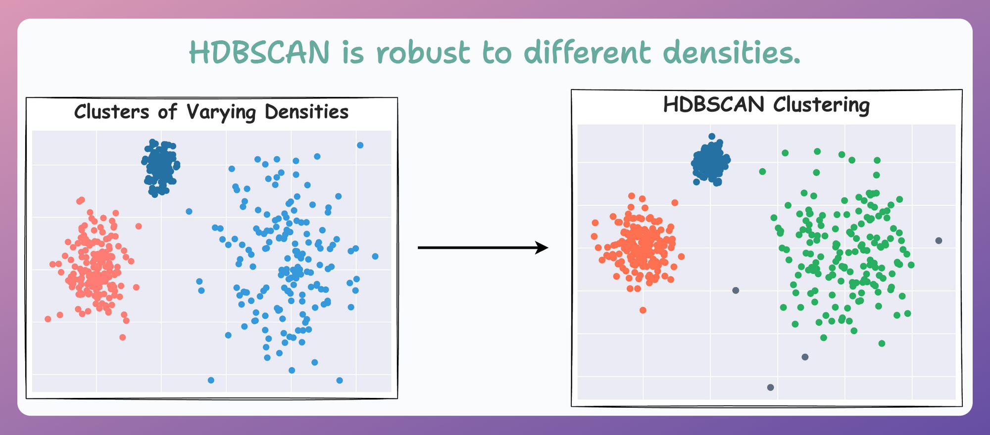
Comparison of DBSCAN & HDBSCAN
https://www.dailydoseofds.com/hdbscan-the-supercharged-version-of-dbscan-an-algorithmic-deep-dive/

Slide 12
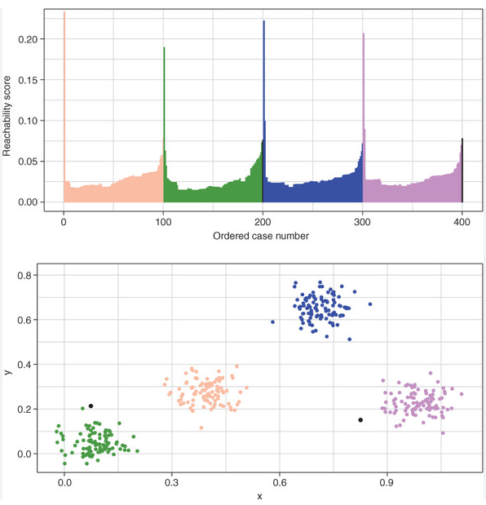
OPTICS (Ordering Points to Identify the Clustering Structure)
Definition: OPTICS is similar to DBSCAN but identifies clusters of varying densities and shapes.
Process:
Orders points based on their density-reachability.
Extracts clusters based on the ordered list.
Advantages: Handles varying density clusters.
Disadvantages:
Sensitivity to parameters − OPTICS requires careful tuning of its parameters, such as the min_samples and xi parameters, which can be challenging.
Computational complexity − OPTICS can be computationally expensive for large datasets, especially when using a high min_samples value.
Use Cases: Financial fraud detection, Environmental data analysis.

Slide 13
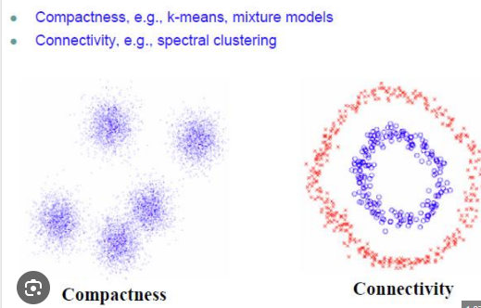
Spectral Clustering
Definition: In Spectral clustering, datapoints are treated as nodes of a graph. So this is a graph partitioning problem.
Process:
Nodes are mapped to low dimensional space that can be easily segregated to form clusters.
The goal of this clustering is to cluster data that is connected but not necessarily compact.
Advantages: Performs well on complex data shapes.
Disadvantage: cannot distinguish between deep cuts and long paths, and that this confusion can cause it to cut a graph in the wrong direction thereby producing the spectral method's worst-case behavior
Use Cases: Image segmentation, Social network analysis.
Notes:
Node is connected only to two data points (vs centroid) and then connect all the nodes. In spectral, clusters don’t follow any pattern.

